Slide 1
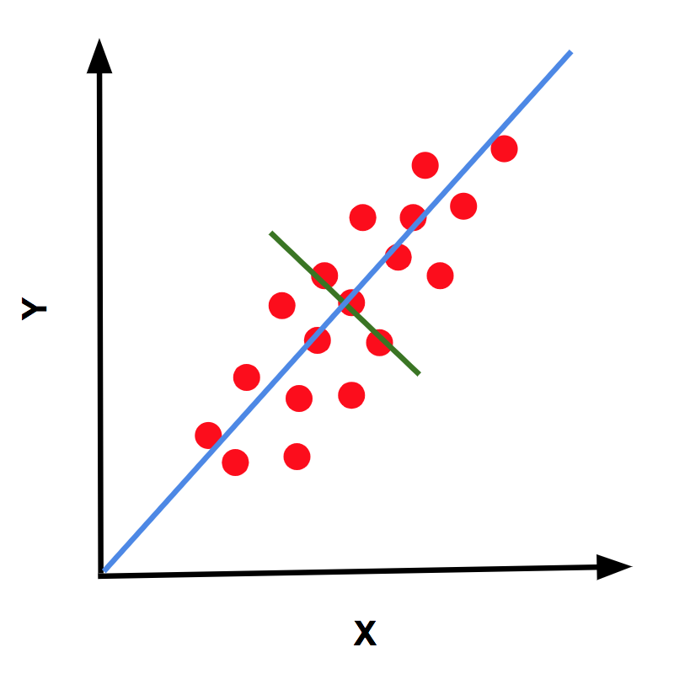
PCA USE-CASE

Slide 2
Chemical Analysis of Wine
We have chemical analysis of 178 different wines produced by vineyards from the same region of Italy.
The wines comes from 3 different grapes – Barolo, Girgnolino, Barbera.
We are trying to identify the type of grape from 13 features from chemical analysis.
Ref: https://archive.ics.uci.edu/ml/datasets/Wine

Slide 3
Which Variable is relevant variable ?

Slide 4
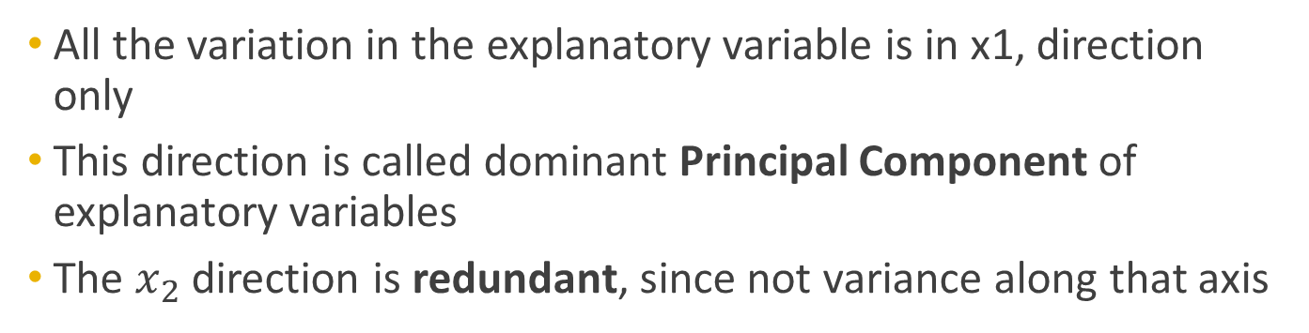
x2
x1
All the variation in the explanatory variable is in x1, direction only
This direction is called dominant Principal Component of explanatory variables
The $x_{2}$ direction is redundant, since not variance along that axis

Slide 5
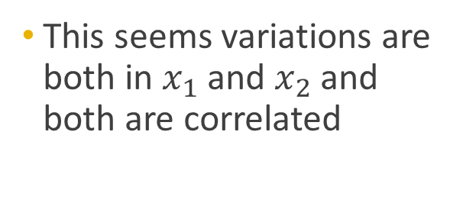
How many relevant features are here ?
x2
x1
This seems variations are both in $x_{1}$ and $x_{2}$ and both are correlated

Slide 6
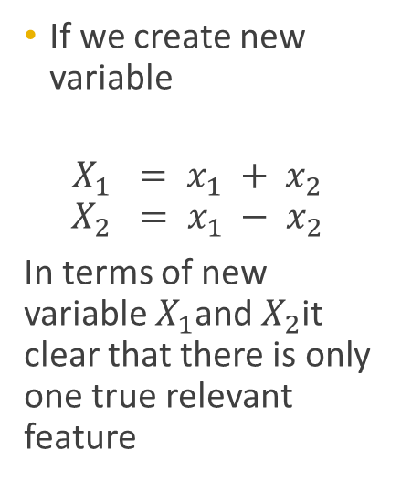
How many relevant features are here ?
If we create new variable
$$X_{1} = x_{1} + x_{2}$$
$$X_{2} = x_{1} − x_{2}$$
In terms of new variable $X_{1}$and $X_{2}$it clear that there is only one true relevant feature

Slide 7
Transformed variables: Interpretation
The transformation we did is equivalent to viewing from the data points from a rotated co-ordinate system.
Green = X1
Red = X2
The dominant
principal component
is X1 axis
X1
x2
X2
x1

Slide 8
Principal Component Analysis
PCA is the method which allows you to identify the “directions” in which most of the variations in the data is present.
Equivalently, it can be thought as method to identify the “directions ” along which there is least variations (or least useful information). Identifying this would allow us to drop this irrelevant direction in our regression/model building.

Slide 9
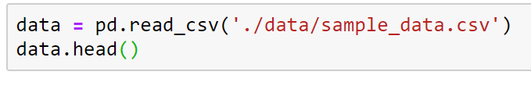

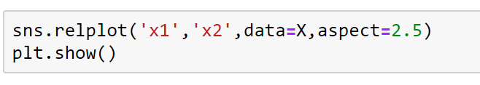
Principal Component directions

Slide 10
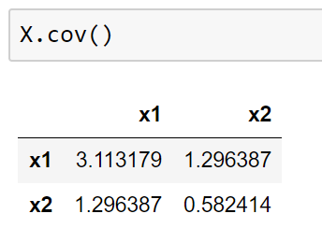

PCA Methodology
Starts with analyzing covariance matrix of features
$$cov= \left[\begin{matrix}cov(x_{1},x_{1}) & cov(x_{1},x_{2}) \\ cov(x_{1},x_{2}) & cov(x_{2},x_{2})\end{matrix}\right]$$
The covariance matrix contains information about both
correlation and the “special direction” of maximal variance

Slide 11
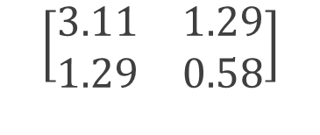

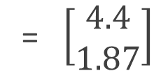
Matrix as a transformation on a vector
b
x2
a
x1
$$\left[\begin{matrix}3.11 & 1.29 \\ 1.29 & 0.58\end{matrix}\right]$$
$\left[\begin{matrix}1 \\ 1\end{matrix}\right]$
= $\left[\begin{matrix}4.4 \\ 1.87\end{matrix}\right]$

Slide 12


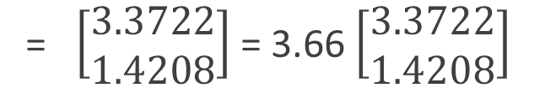
Matrix as a transformation on a vector
Special Vectors
$$\left[\begin{matrix}3.11 & 1.29 \\ 1.29 & 0.58\end{matrix}\right]$$
$\left[\begin{matrix}0.9215 \\ 0.3882\end{matrix}\right]$
= $\left[\begin{matrix}3.3722 \\ 1.4208\end{matrix}\right]$ = 3.66 $\left[\begin{matrix}3.3722 \\ 1.4208\end{matrix}\right]$
For given matrix there are special directions, along which its effect only to stretch
(without rotation). Such direction is called Eigen direction or Eigen vectors

Slide 13
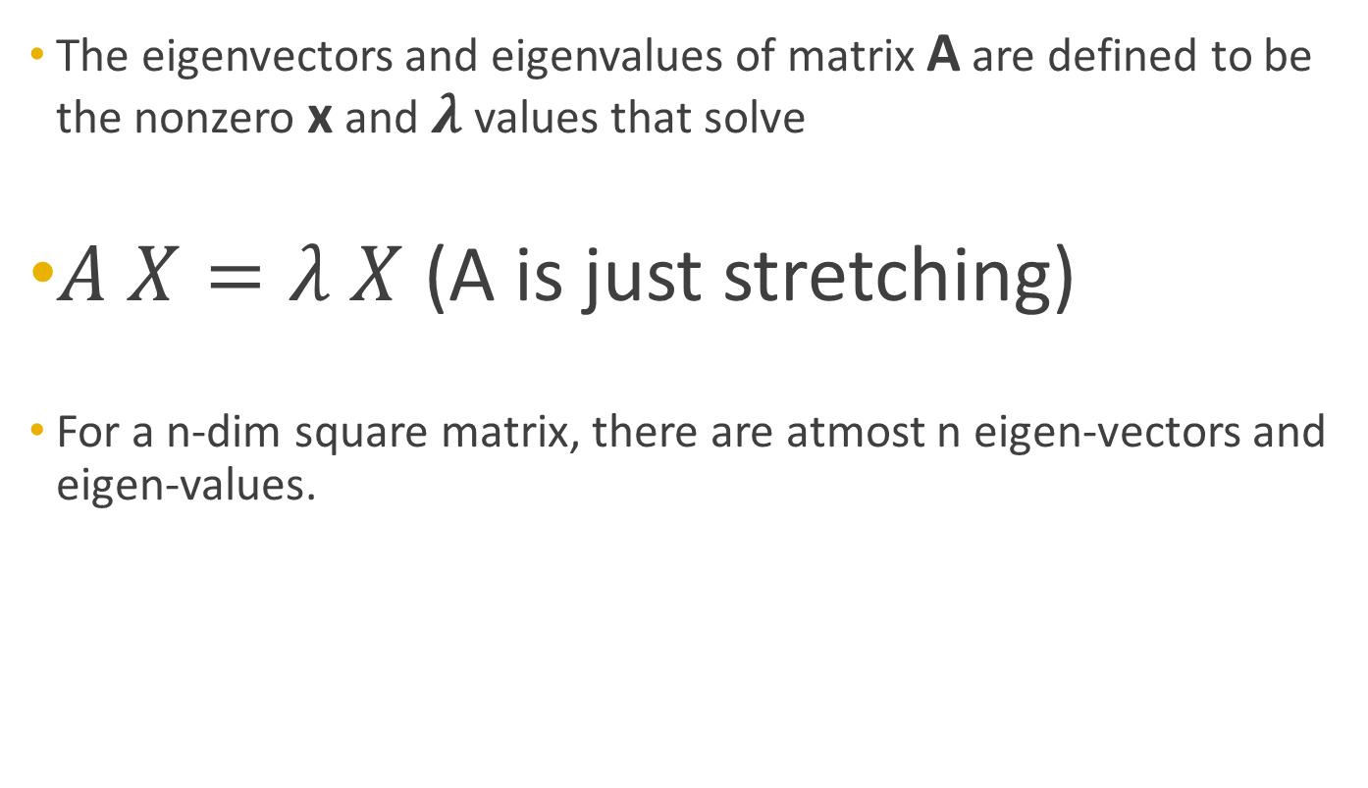
Eigen vectors mathematics
The eigenvectors and eigenvalues of matrix A are defined to be the nonzero x and $λ$ values that solve
$A X=λ X$ (A is just stretching)
For a n-dim square matrix, there are atmost n eigen-vectors and eigen-values.

Slide 14
Eigen vectors & PCA
Eigenvectors are the principal component directions
Eigenvalues are the magnitude of stretch
Eigenvalues represent the magnitude of variance of those directions

Slide 15
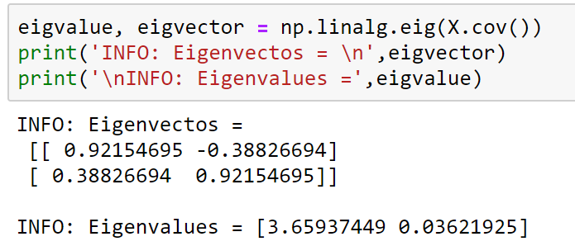
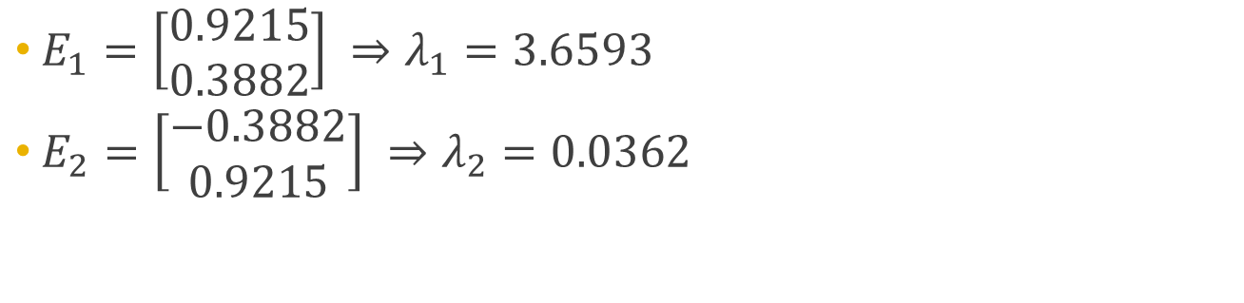
Eigen values and Eigen vectors
$E_{1}=\left[\begin{matrix}0.9215 \\ 0.3882\end{matrix}\right] ⇒λ_{1}=3.6593$
$E_{2}=\left[\begin{matrix}−0.3882 \\ 0.9215\end{matrix}\right] ⇒λ_{2}=0.0362$
Dominant
Principal Component

Slide 16
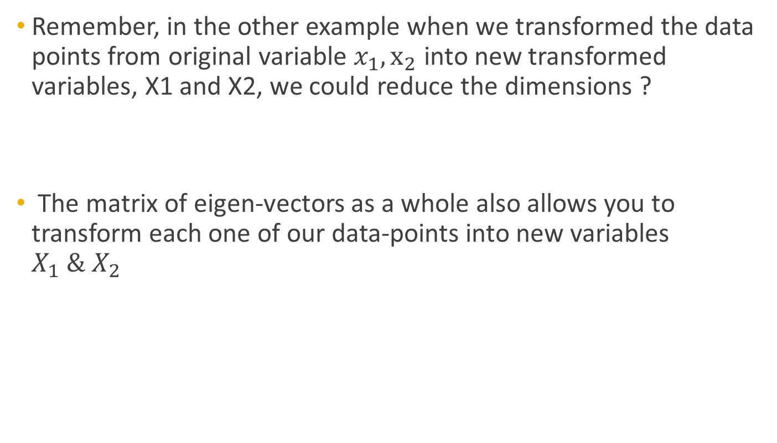
Eigen vector and Eigen values
Remember, in the other example when we transformed the data points from original variable $x_{1}, x_{2}$ into new transformed variables, X1 and X2, we could reduce the dimensions ?
The matrix of eigen-vectors as a whole also allows you to transform each one of our data-points into new variables $X_{1} \& X_{2}$

Slide 17
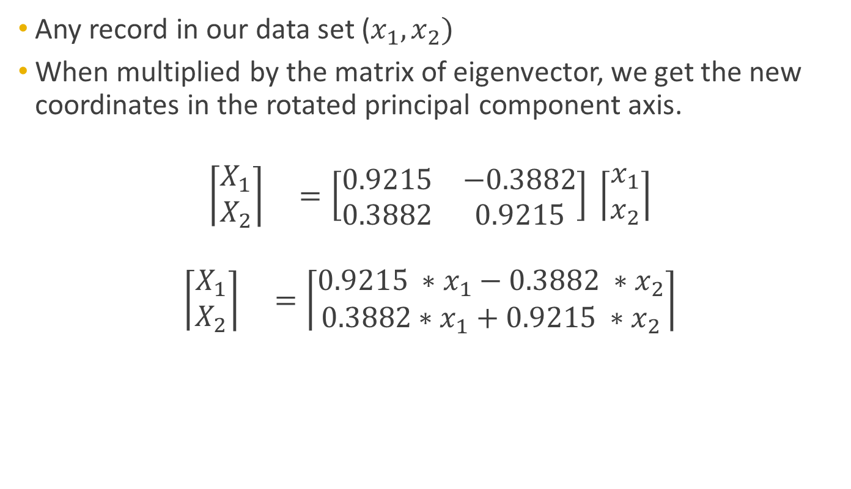
Transform into Principal Component
Any record in our data set ($x_{1}, x_{2})$
When multiplied by the matrix of eigenvector, we get the new coordinates in the rotated principal component axis.
$$\left\lceil \begin{matrix}X_{1} \\ X_{2}\end{matrix}\right\rceil =\left[\begin{matrix}0.9215 & −0.3882 \\ 0.3882 & 0.9215\end{matrix}\right] \left\lceil \begin{matrix}x_{1} \\ x_{2}\end{matrix}\right\rceil$$
$$\left\lceil \begin{matrix}X_{1} \\ X_{2}\end{matrix}\right\rceil =\left\lceil \begin{matrix}0.9215 ∗x_{1}−0.3882 ∗x_{2} \\ 0.3882∗x_{1}+0.9215 ∗x_{2}\end{matrix}\right\rceil$$

Slide 18
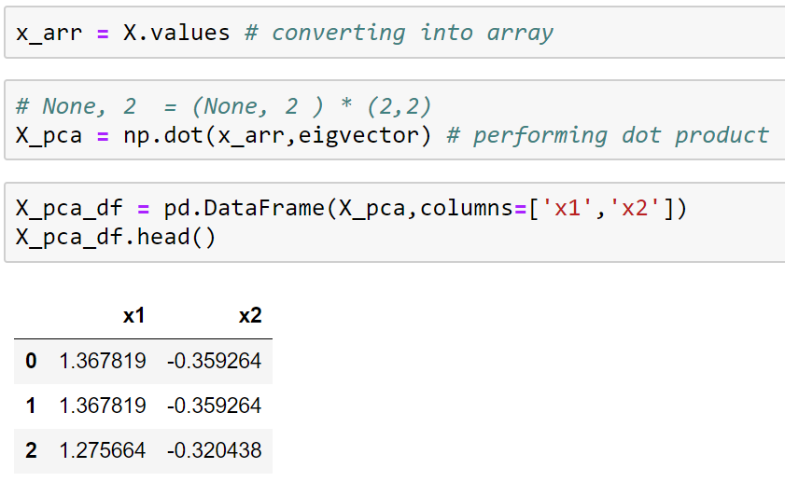
Var(X1) = 3.65
Var(X2) = 0.0362

Slide 19
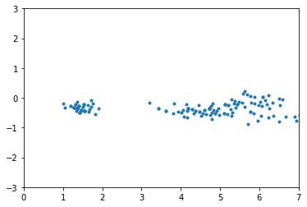




Data transformed into basis of Principal Component
$$X_{2}$$
$$x_{1}$$
$$x_{2}$$
$$X_{1}$$
X2 variable has small variance, we can now drop it by setting it to zero

Slide 20
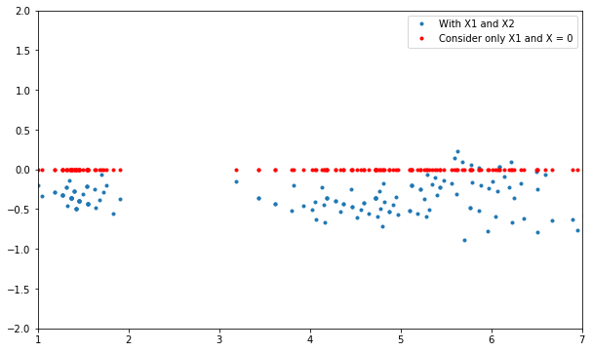

Dimensionality Reduction
$X_{2}$ has been set to zero
X2
X1
So, now instead of doing regression for $x_{1}, x_{2}.$ PCA allows to do regression only with $X_{1}$.
This is point of doing PCA. It allows us to ignore variable with low variance

Slide 21
Reference

